Slide 2
Colors and usage
Duration: 45 mins
Session by: Nargis Jamadar, Ganesh Gholap

Slide 3
At the end of this session:
Colors and usage
Know the basics of color psychology and its impact
Create a color palette using color usage principles
Apply the best practices of color process in UI

Slide 4
Overview

Slide 5
Role of colors in human life

Slide 6
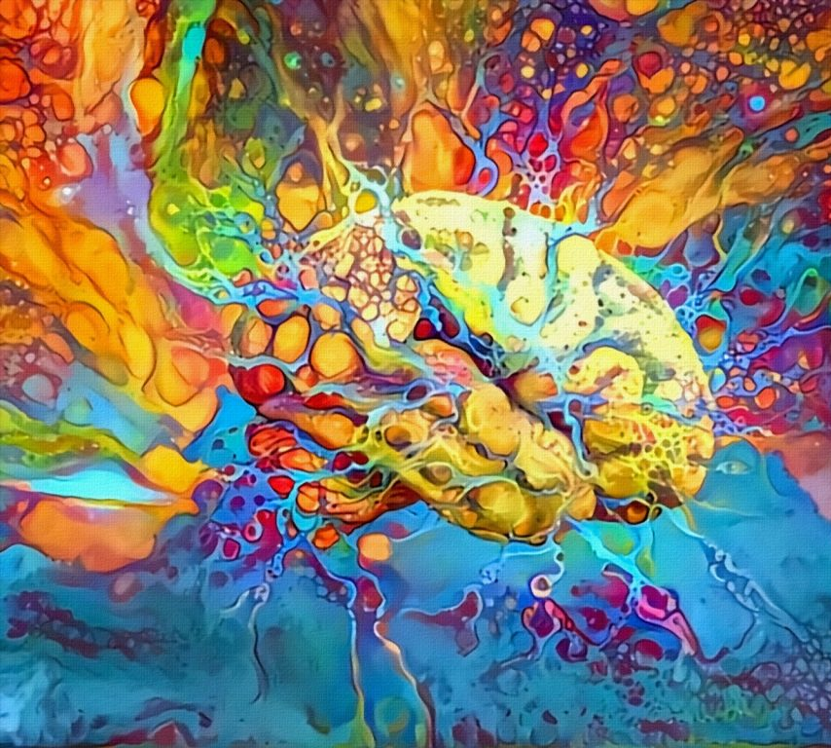
Colors play a vital role in our lives and influence how we respond to our surroundings. The colors you surround yourself with can influence your perspective and emotions, as well as those around you.
Image source: Color meanings
Notes:
Image source: https://www.color-meanings.com/why-color-important-everyday-life/
Color is an important part of everyday life. Bring the importance of color up with people and there will seldom be any real disagreement. Most people agree that color is an important, even vital, part of life. However, there’s a larger question about how well people really understand that fact on a fundamental level.
When people talk about the importance of color, it’s often in a somewhat abstract sense. People know that color is important. However, they can’t really express why color is important or what lack of it might mean to someone’s quality of life
Humans have some of the most sensitive eyes on the planet. We have a type of vision classified as trichromatic. This essentially means that our eyes have three different types of color receptors known as cone cells.
In total we’re able to see up to 10 million different colorsthrough activation of different patterns of our cone cells. In contrast, most of our fellow mammals are dichromats .
For a long time people knew that long term exposure to bland environments puts a certain mental strain on their psyche. Today this experience is better understood as the end result of removing the essential element of environmental enrichment. The term enrichment might be familiar to people who’ve recently visited a zoo. Zoo’s use the term enrichment to describe how they recreate an immersive environment which caters to a species’ particular needs. Basically, an animal’s mental health depends on its ability to get everything it needs from the local environment.

Slide 7
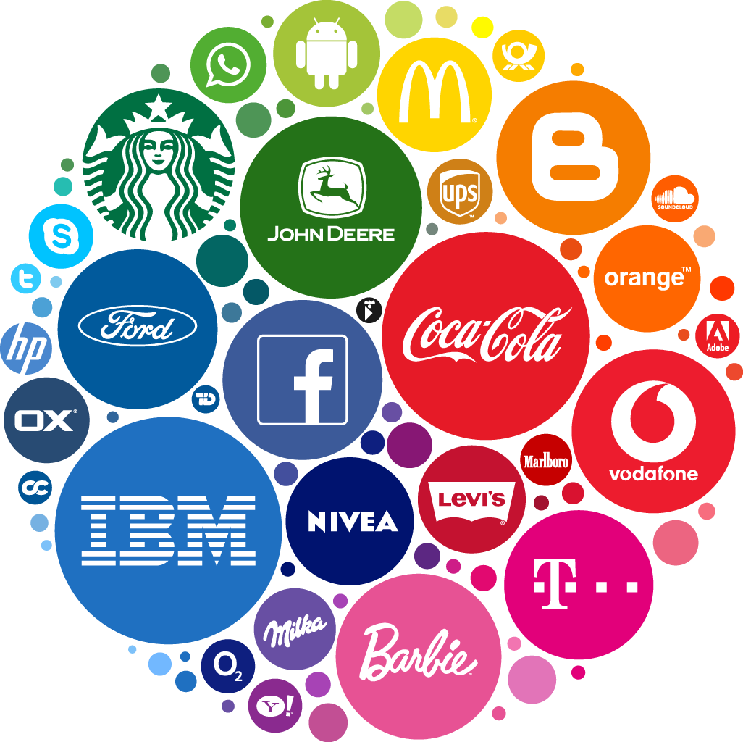
Color psychology
Colors and usage
Color psychology is an important factor that influences user’s emotions and reactions towards a brand.
Colors can help a design stand out by grabbing the user’s attention
Greatly affect the buying decision of users
Increase brand recognition by 80%
Notes:
Green exercise has been growing in popularity as more and more people experience its wide range of benefits. Green exercise is basically just any kind of exercise done in colorful natural environments. This can range from long term high impact trail running all the way to a light hike. In fact, mental and physical benefits were seen from as little as a five minute walk in the park.
Even minor changes in the workplace can provide a big benefit as well.
So this is how colour affects the human mind, the same concepts are used when we engage with the user. What color comes to mind when I say Coca-Cola? How about McDonald’s? Brands like these have used brand color psychology to create powerful associations in the minds of their customers. Brand color psychology is about more than just associating a brand with its signature color, though. It’s about the feelings and emotions these colors inspire in us.
An understanding of color psychology in branding gives you one more tool in the underlying goal of branding: shaping the perceptions that drive consumer behavior. While the effect that colors have on our emotions differs from person to person based on gender, cultural context, personal experience, and neurological variances, there are some general guidelines that have been borne out by countless color psychology studies.
Greatly affecting buying decision: Let’s see if the CTA is not poping out in the design, that may lead into droping out the customer. Thus colors can affect the buying decisions.

Slide 8
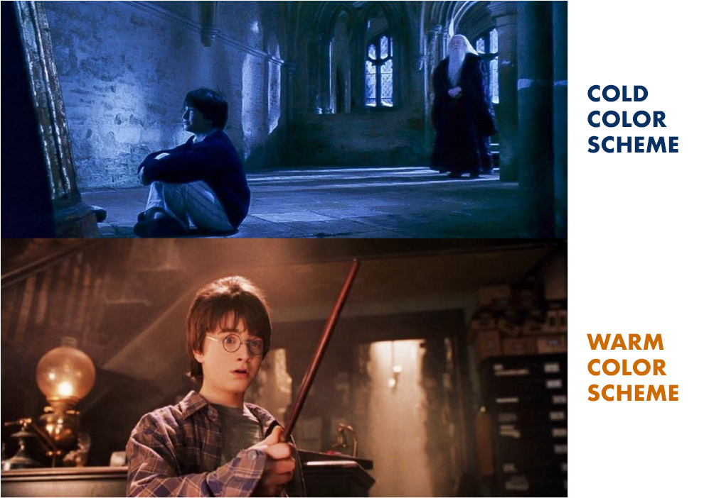
Color psychology
Colors and usage
This example shows how colors are used to trigger emotional response from the audience.
Joyous scenes are set in warm color schemes whereas sad, melancholic tones are portrayed with cold color schemes.
Harry looking at his dead parents vs. Harry rejoicing at being united with his wand.
Image source: Medium
Notes:
https://medium.muz.li/the-importance-of-color-a-brief-look-into-the-color-psychology-of-everyday-life-581072bc221e
In film colour schemes are used to set the tone of the scene. This is so effective that you know what emotion the scene carries even before the actor utters a word. Joyous scenes are set in warm colour schemes whereas sad, melancholic tones are portrayed with cold colour schemes. In scenes building up for passion look for reds, impending doom look for greys, creativity and fantasy is usually purple. The usage of colours in film is a an art in itself. I’ll make a post in detail about it in the future. We’ll stick to colours use to manipulate emotions in everyday life in this post. Here’s a small example of warm and cold colour usage in a movie.

Slide 9
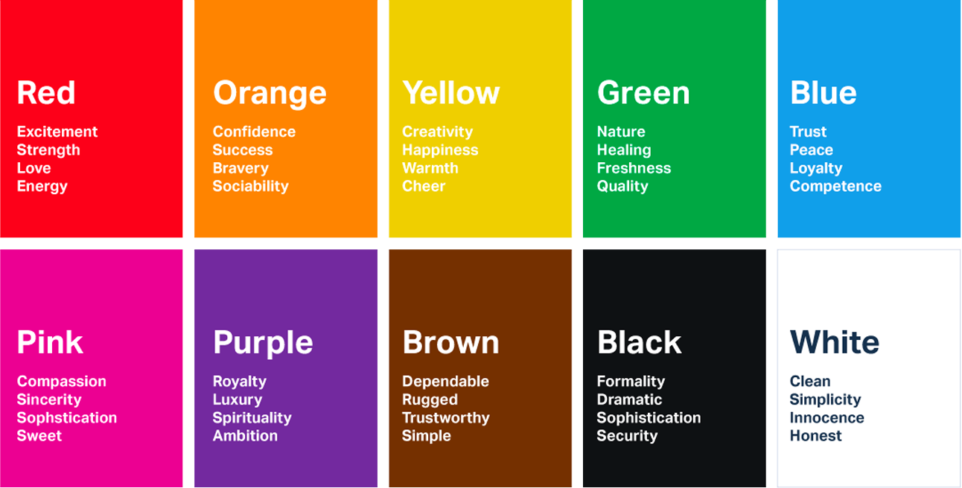
Colors and usage
Emotions and actions evoked by color
Notes:
General emotions evoked by the colours. This may depend upon person, culture and surroundings as well.
https://link.springer.com/chapter/10.1007/978-3-319-58484-3_32

Slide 10
How color affects users?

Slide 11
Color affects emotions, emotions affect decisions.

Slide 12
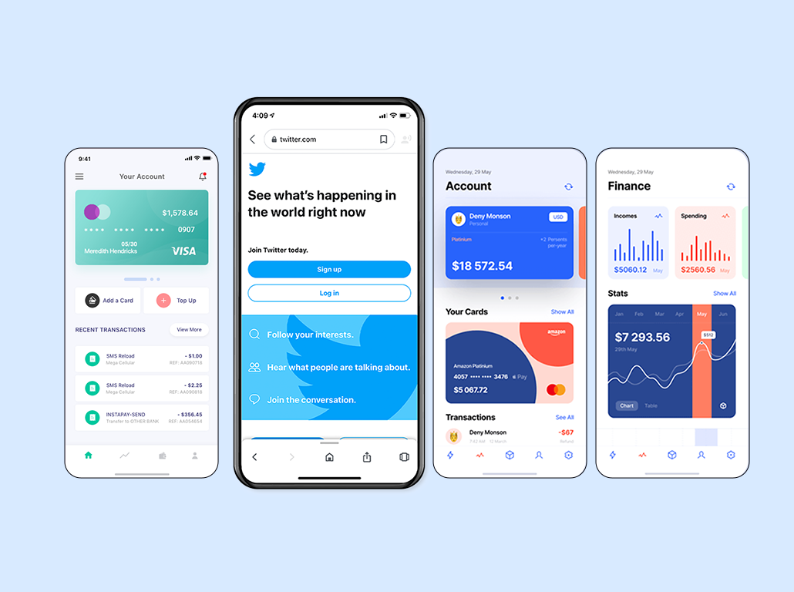
Colors and usage
Green and blue are the most common colors in nature and provide better healing.
That’s why they are used in healthcare and banking app designs.
These colors enable users to make vital choices without stressing out.

Slide 13
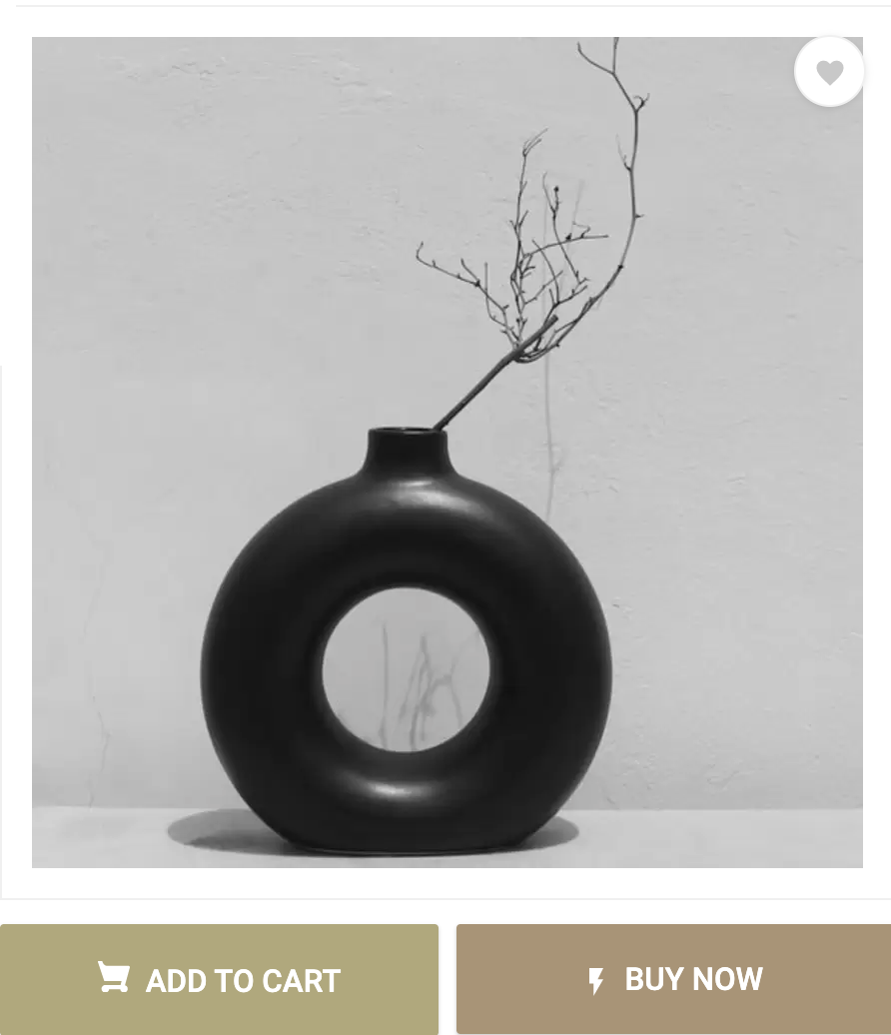
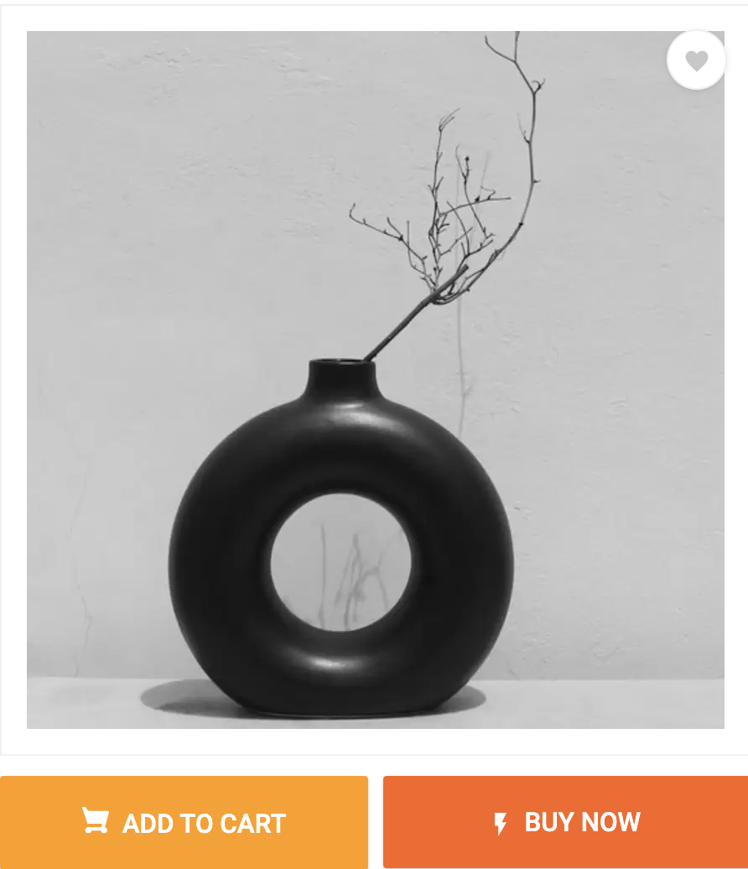
Colors and usage
Which option do you think will persuade you to click the Buy Now call to action?
Notes:
Colours affect the buying decisions.

Slide 14
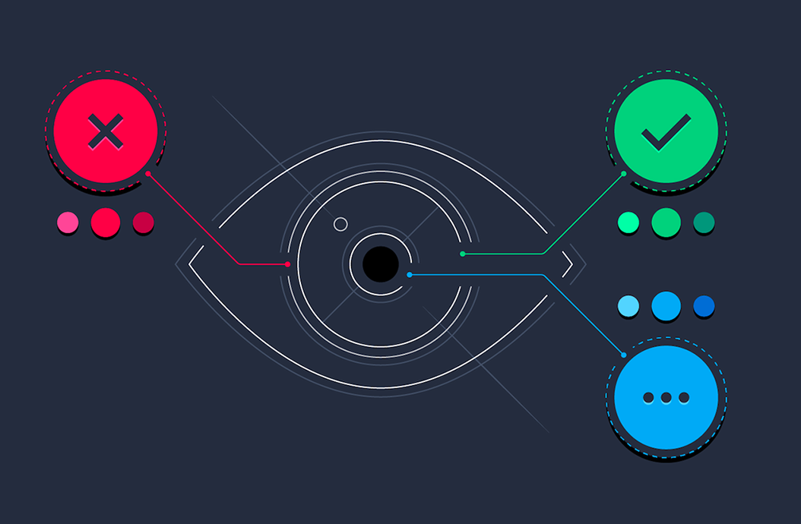
Colors and usage
Predicting user reactions to color appropriateness is more important than the individual color itself when it comes to picking the right palette for the interface.
Notes:
https://uigstudio.com/insights/role-of-colors-in-ux-and-ui-design

Slide 15
Colors and usage
Colors and UI design
People take only 90 seconds to make subconscious judgments about a product and
62% - 90% is based on color alone.
Thoughtfully selected colors help put users in the frame of mind to take action.
Right color combinations affect the attractiveness of
UI and enhance the usability level
Notes:
https://www.quicksprout.com/psychology-of-color/
92.6% of people say the visual dimension is the #1 influencing factor affecting their purchase decision (over taste, smell, etc.).
Studies suggest that people make a subconscious judgment about a product within 90 seconds of initial viewing. Up to 90% of that assessment is based on color alone.
One study found that magazine readers recognize full-color ads 26% more often than black-and-white ads.
Heinz changed the color of their signature ketchup from red to green and sold over 10 million bottles in the first 7 months, resulting in $23 million in sales.

Slide 16
Quick facts The average human can perceive one million colors. The colors you see may not always be the same someone else sees.
Notes:
The average human can perceive one million different colors, but researchers suspect that a small percentage of women may be capable of seeing one hundred times that amount.
Women have always doubted this; now a new study has confirmed that men have a far higher chance of struggling to tell the difference between hues*, as one in 12 of them are color blind compared to one in 255 women. Researchers at Newcastle University also believe that some women may be able to see 99 million more colors than the average human being.

Slide 17
Color process in UI design

Slide 18
How to create color palette?

Slide 19
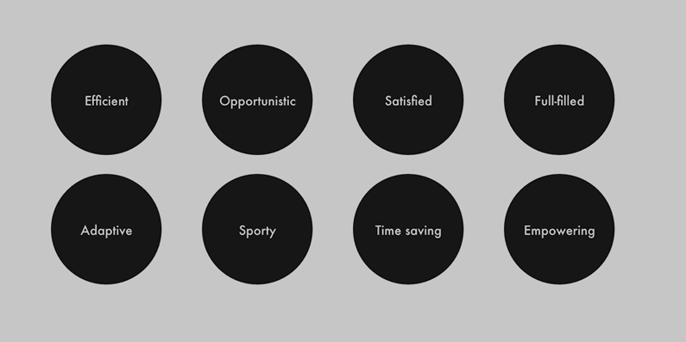
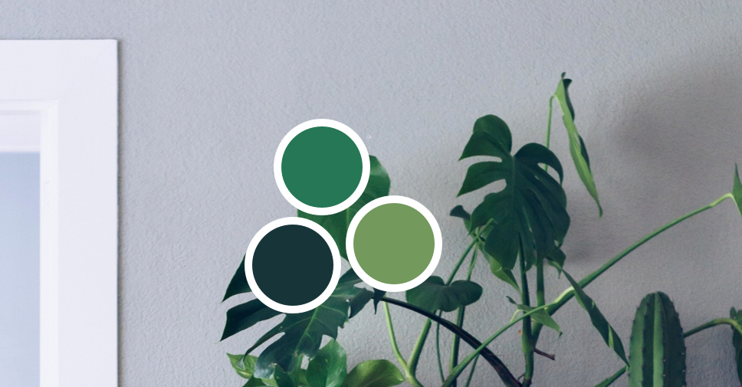
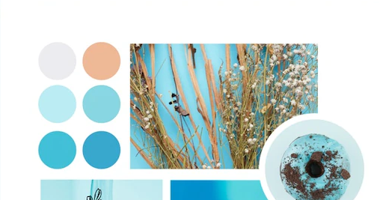
Colors and usage
Creating color palette
Check the brief and identify the brand attributes
Get inspired by nature and other color palette inspirations
Create mood boards around the chosen colors

Slide 20
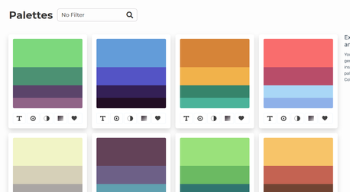
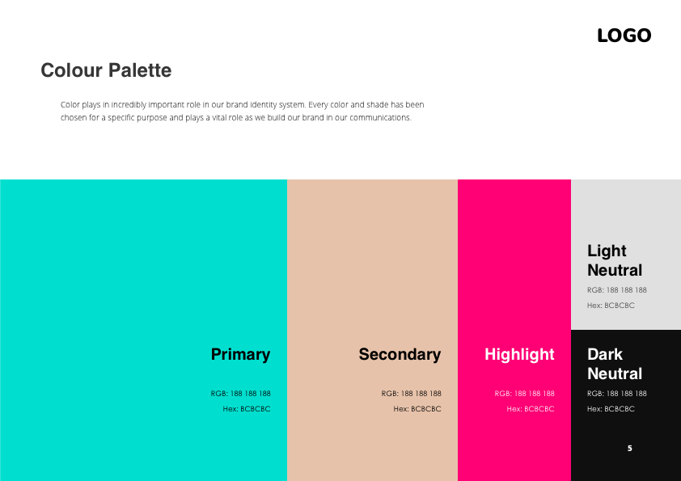

Colors and usage
Creating color palette
Try different combinations and moods suited to client
Decide on the primary and secondary colors
Check the contrast for accessibility

Slide 21
Colors and usage

Slide 22
The rule of 60 - 30 - 10

Slide 23
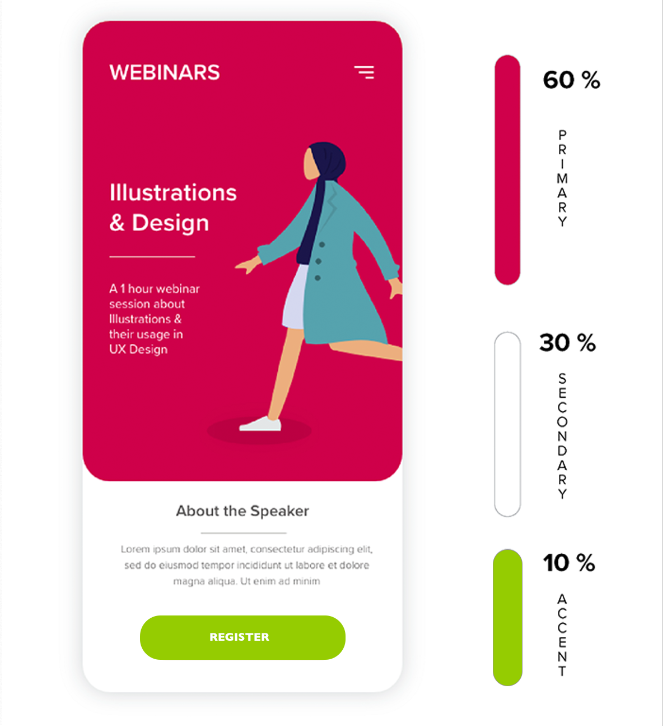
Colors and usage
The 60-30-10 rule is used a lot in designs.
The proportion to successfully combine colors
Choose a dominant color and use it in 60% of the space
Add a secondary so that it is in 30%
Add the accent color for the remaining 10%. This can be used for CTAs.
Notes:
https://uxplanet.org/5-simple-tips-on-using-color-in-your-design-40916d0dfa63#:~:text=The%2060%E2%80%9330%E2%80%9310%20Rule&text=The%20idea%20is%20simple%20%E2%80%94when,remaining%2010%25%20of%20the%20design.

Slide 24
Color usage principles

Slide 25
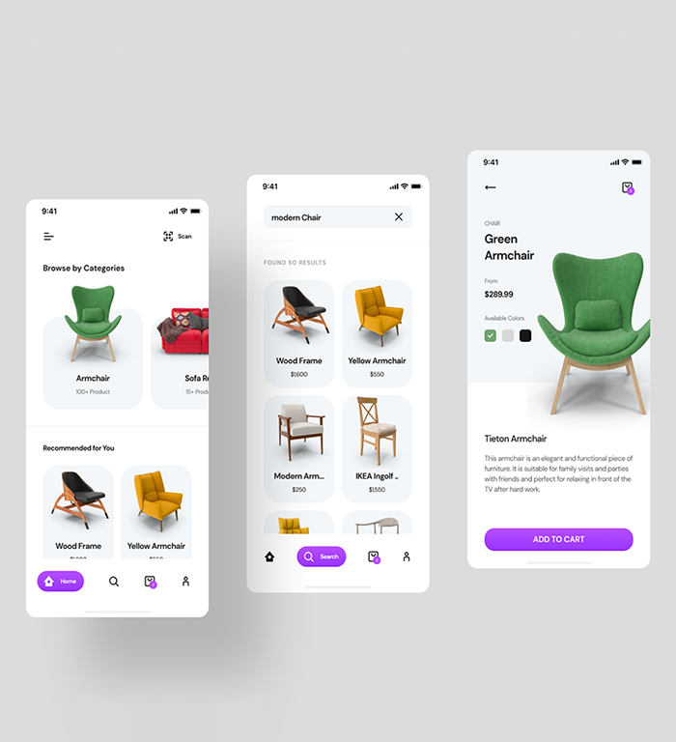
Colors and usage
Consistent
Color should be applied throughout a UI consistently and be compatible with the brand it represents.
Source: Google Material design.

Slide 26
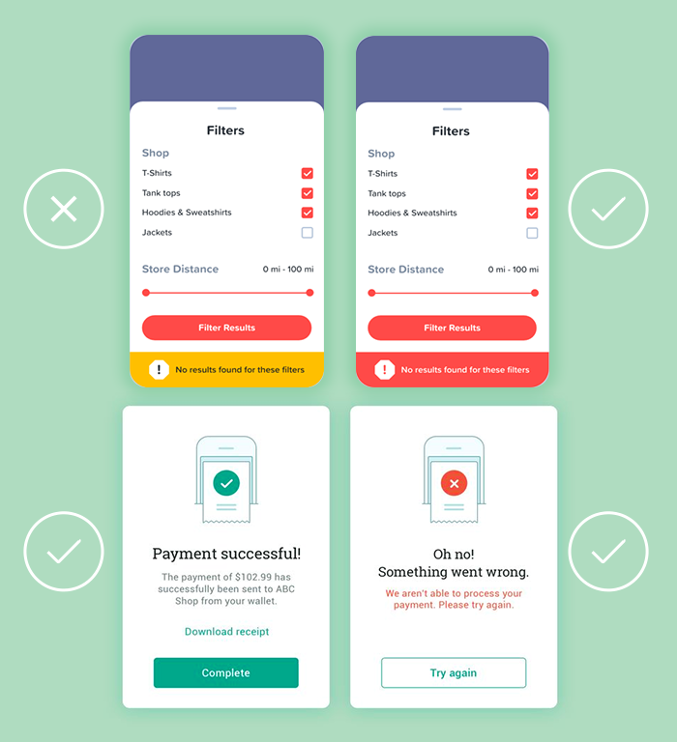
Colors and usage
Distinct
Color should create distinction between elements, with sufficient contrast.
Source: Google Material design.

Slide 27
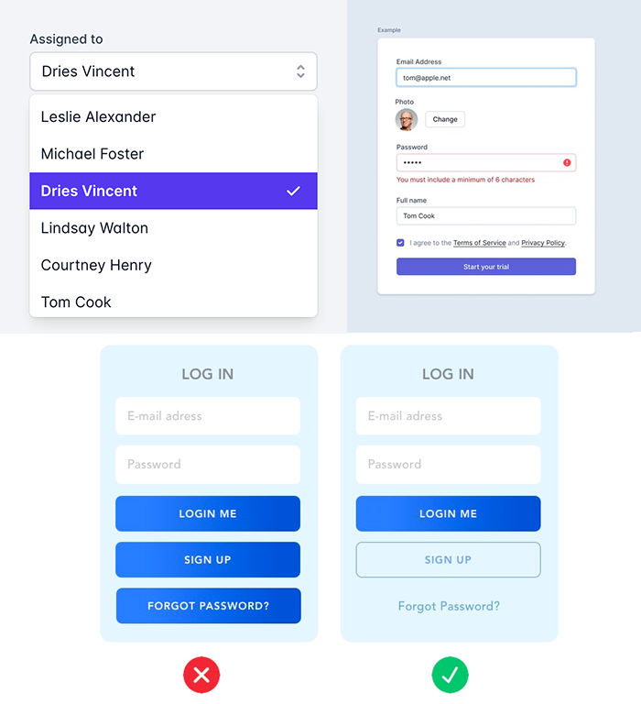
Colors and usage
Intentional
Color should be applied with intention as it can convey meaning in multiple ways, such as relationships between elements and degrees of hierarchy.
Source: Google Material design.

Slide 28
Key color practices in UI design

Slide 29
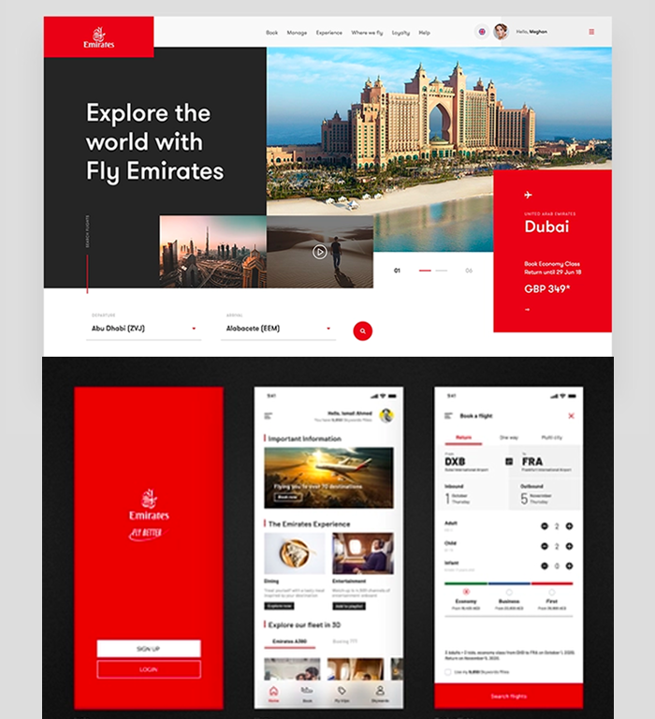
Colors and usage
Connection with the brand
Brand colors help your design to stand out. This is how the design creates visual solutions that connect all communication channels of the company and enhances brand awareness.
Source: Google Material design.
Notes:
https://material.io/design/color/color-usage.html#brand

Slide 30
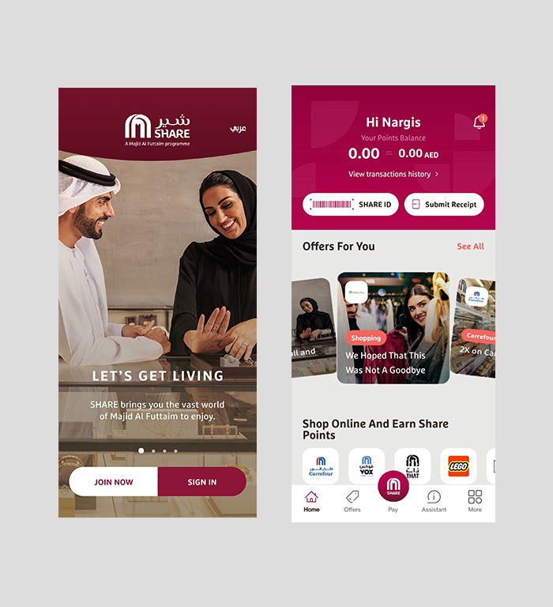
Colors and usage
Balanced color combinations
Color schemes work best if the quantities of colors used for the design are not equal. Higher interest is generated by using variety of color proportions that play an emphatic or accentuating role
Source: Google Material design.
Notes:
Improper use of color can easily overwhelm your users. If you don’t want to distract or confuse your users, you should try to achieve harmony in your design. And this happens only when you have a balance in the visual experience.
Here are a few simple rules that can help you with that:
The 60–30–10 Rule
The rule of max 3 colors
“Do not wear more than three colors in an outfit otherwise you’ll look like a clown or a parrot” — this is common advice that personal stylists give to their clients. Unless you’re an expert in combining colors, it’s better to limit the total number of colors you use in your design.
If you think your design needs more colors, try to use darker & lighter variations of already selected colors.

Slide 31
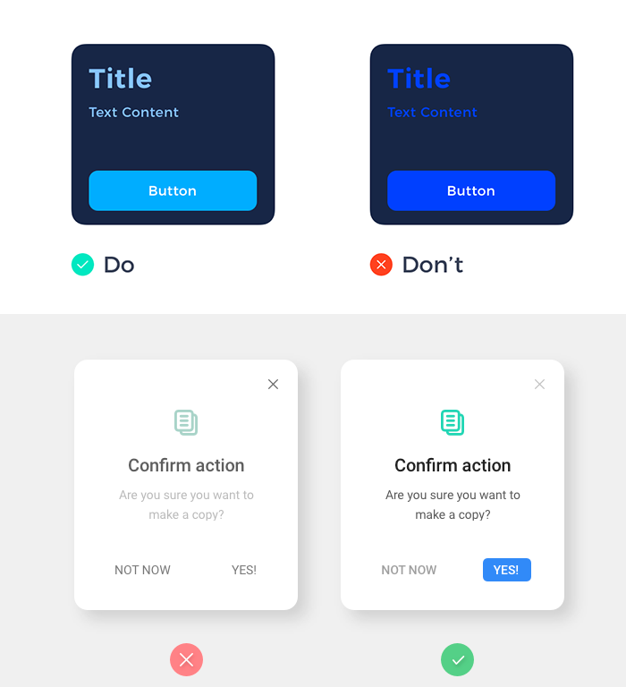
Colors and usage
Contrast and accents
Correct color contrast brings individuality to each element of the UI and makes them all noticeable.
Going for single color may look minimalistic but may not attract attention.
If the copy and background colors contrast too much with each other, the copy loses its significance.
To be accessibility compliant, follow W3C standard as a process.
Source: Google material design.

Slide 32
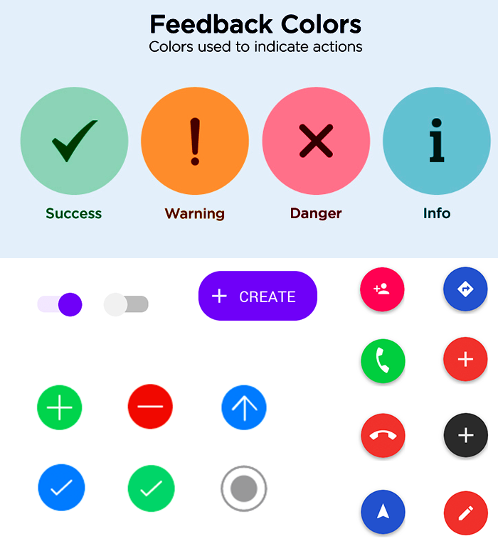
Colors and usage
Use colors with a purpose
All colors have unique characteristics and should be used with a purpose.
Color libraries have established meanings for colors such as red, green and yellow to indicate specific information such as error, notification, and caution.

Slide 33
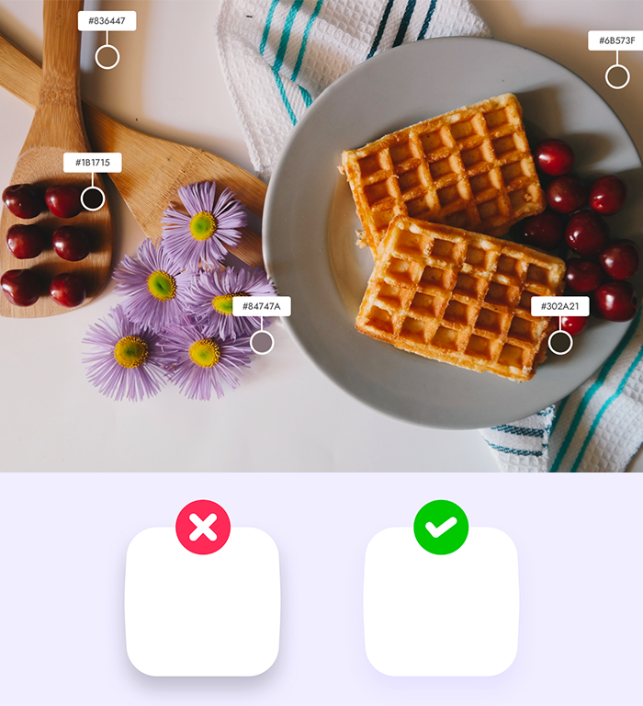
Colors and usage
Shadows are never black
A common design mistake is to use black color with opacity to make a shadow
Darkness always has some tones of its base. Darkness is never black. Darkness is the color tone of the object that is shaded with value tones.
Notes:
Go with more natural colors that’s the key to make design look natural and easy on eyes.

Slide 34
Color usage for accessibility

Slide 35
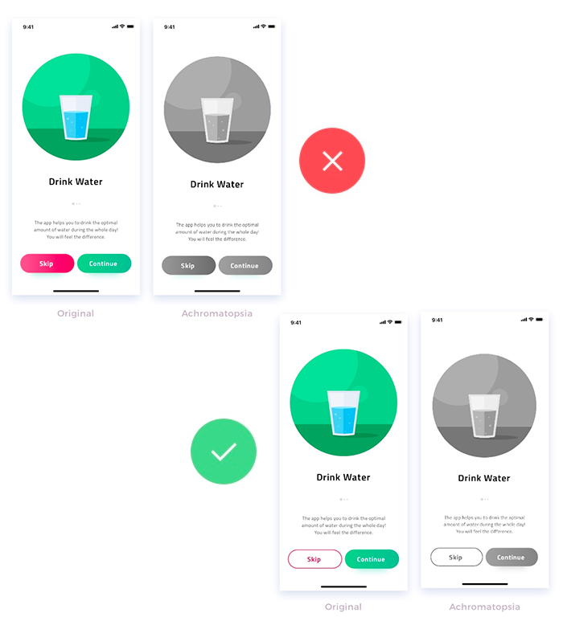
Colors and usage
Color blindness
Colour blindness affects 8% of males and 0.5% of females globally
Use safe colors
Experiment with different design treatments
*. Weinschenk, S., 2011. 100 Things Every Designer Needs To Know About People. New Riders, pp.23, 28. material design.

Slide 36
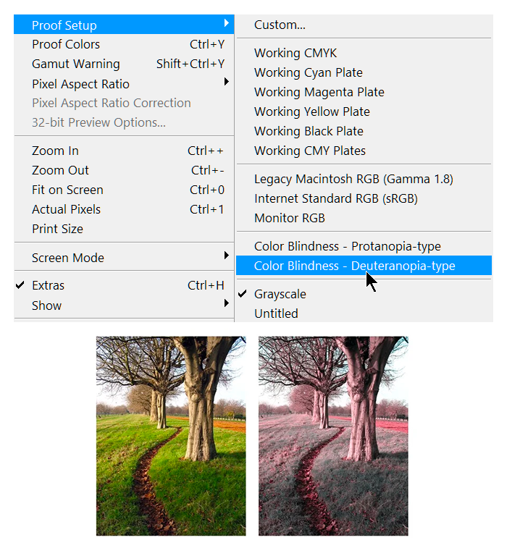
Colors and usage
Color-blindness simulators for accessibility
Adobe Photoshop has useful tools to simulate color-blindness,
Stark - a paid Sketch plugin that lets you simulate types of color blindness
Toptal’s color filter - this online tool lets you test your website for accessibility

Slide 37
Key takeaways
Color is a tool which affects decision making
Color usage principles and key practices to use them
Rule of 60, 30, 10 and how to use it
Importance of accessibility

Slide 38
Thank you!

